Slide 1
CS 170 Intro to Artificial Intelligence
Notes based from Dr. Eamonn Keogh

Slide 2
TextBook
Optional: Artificial Intelligence: A modern approach by Stuart Russell and Peter Norvig

Slide 3
What is AI?
“The capacity of a digital computer to perform tasks commonly associated with the higher intellectual processes characteristic of humans, such as the ability to reason, discover meaning, generalize or learn from past experience” –Encyclopaedia Britannica
AI is trying to solve by computer any problem that a human can solve faster/better -FOLDOC

Slide 4
Why Study AI? Part I
Computers with intelligence would have (are having) a huge impact on civilization
Unlike faster-than-light-travel or time travel devices, there is strong evidence that AI is actually possible (hint, it is between your ears).
AI (along with genetics) is most often cited as “the field I would most like to be in” by researchers in other fields
Personal motivation: The last big mystery

Slide 5
Why Study AI? Part II
Some people who study AI are only interested in solving problems. Other reasons like this … “I want to study humans, since the most interesting feature of humans is their intelligence, I will study artificial intelligence to understand true intelligence”
This has always struck me as a weak argument. The very earliest attempts at flight tried to emulate birds by building flying machines that flapped their wing (ornithopters). Although manned aircraft can hover/carry enormous loads/fly faster than sound, no manned orthopter has every flown

Slide 6
Why Study AI? Part III
There is a huge need for AI researchers and practitioners.
This has created a bidding war for talent
Experts in AI (or machine learning, data science, data mining etc.) have lots of high paying job opportunities
(Reueters) – Apple has ramped up its hiring of artificial intelligence experts, recruiting from PhD programs, posting dozens of job listings and greatly increasing the size of its AI staff, a review of hiring sites suggests and numerous sources confirm…

Slide 7
Where are we in AI?
AI is trying to solve by computer any problem that a human can solve faster/better
So we can use the performance of AI on a given problem as:
-optimal: it is not possible to perform better
-strong super-human performs better than all humans
-super-human: performs better than most humans
-par-human: performs similarly to most humans
-sub-human: performs worse than most humans

Slide 8
-optimal: it is not possible to perform better
Arithmetic (now not normally considered an AI problem)
Checkers (draughts)
Rubix’s cube (as we will see, AI takes 20 moves or fewer)
15-puzzle (But not optimal for larger versions)
Playing poker (most variations)
Shortest route Finding (i.e. directions on google maps)

Slide 9
-Super human: performs better than most humans
Backgammon: since about 1992
Chess: Since about 1997
Crosswords:
Jigsaw puzzles
Scrabble:
Quiz show question answering
Driving a car: super human. With qualifications

Slide 10
-super-human: performs better than most humans
Cryptoanalysis

Slide 11
-par-human: performs similaryly to most humans
Optical character recognition for certain fronts (ISO 1073-1 MICR)
Brdige (card game)
Many Image classification problems
Such as if there is a face in an image?
What is the sex/age of the person?
Is this person happy/sad/surprised/angry/disguisted?
Is this person Michael Smith?
Is this person attractive?

Slide 12
-sub-human: performs worse than most humans
Handwritting recognition (but closing fast)
Language translation (i.e. English to Chinese)
Speech recognition (but closing very fast)
Word-sense disambiguation
Natural language processing
Captcha (by definition)

Slide 13
-sub-human: performs worse than most humans
Common sense reasoning

Slide 14
The ultimate goal of AI
We don’t want to have lots of different programs to solve lots of different problems, Narrow AI
(imagine if we different sorting algorithms for sorting names, sorting ages, sorting heights, sorting GPAs, sorting dollars, sorting euros etc.)
We would like a single program that can do everything Artificial General Intelligence (AGI)
AGI is sometimes called Strong AI or Full AI or high level machine intelligence (HLMI)
How would we know if we ever achieve AGI? That is a surprisingly deep question…
The answer, like many things in CS, comes from…

Slide 15
How do we know if we have succeeded
The turing test
The human must try to determine if he is talking to a human or a machine
The computer can lie!
The test does not check the ability to give correct answers to questions only how closely answers resemble those a human would give
The conservation would be limited to a text-only channel such as a computer keyboard and screens so that the result would not be dependent on the machines ability to render words as speech

Slide 16
What questions would you ask in a Turing Test
What is the cube root of 13? (computer is allowed to pause and give an approximate answer)
My king is on the K1 square, and I have not other pieces. You have only your king on the K6 square and a Rook on the R1 square. Your move (this is in turings paper in 1950; he realized that chess-playing computers would be inevitable, Rook to R8, checkmate)
For which country is the flag a red circle on a white background
John is fat and tall and in a very bad mood, his dad David, is illiterate, lvoes Chinese food and wears ugly clothes, who is older John or David (I added red herrings)
What would an “M” look like if you were standing on your head?
What do think of Roald Dahl? (and probe with follow up questions)
Bob weighs 12 poinds. Bob likes to chase mice, Bob is afraid of dogs. What is Bob

Slide 17
A stunning idea
If one day we have Artificial General Intelligence, then the next day we will have Superintelligence
This is sometimes called “the singularity”
See recent works by
Ray Kurzweil
Nick Bostrom

Slide 18
When, if ever, will we have AGI?
Katja Grace asked all researchers who published at the 2015 NIPS and ICML conferences (top AI venues)
There was huge variation in the responses, including some folk who claim never
However, the aggregate forecast gave:
A 50% chance of HLMI occurring within 45 years
A 10% chance of it occurring within 9 years

Slide 19
The Best Case
We obtain strong AI…
….now 99.9% of all humans are now unemployed but that is OK
We can control the AI, and we use it to cure cancer, create renewable energy, to explore the universe…

Slide 20
The worst case
We obtain strong AI
The AI kills us all
Or
Humans weaponize the AI

Slide 21
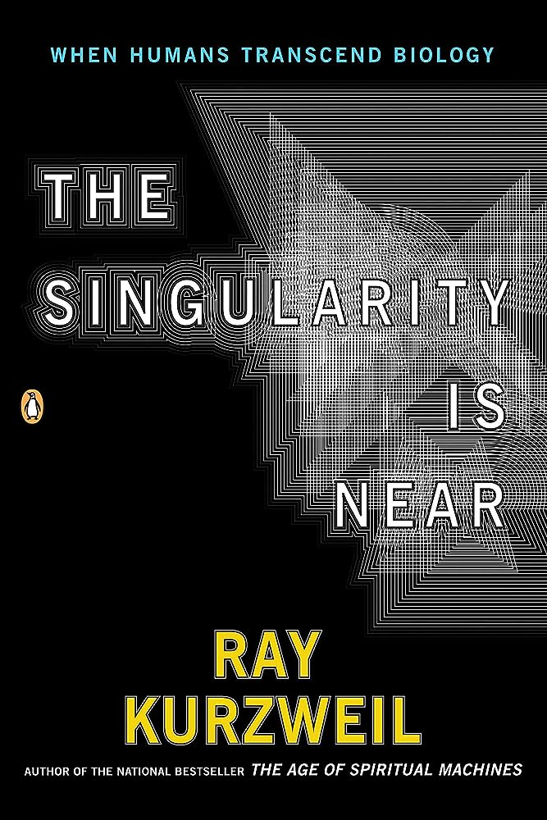
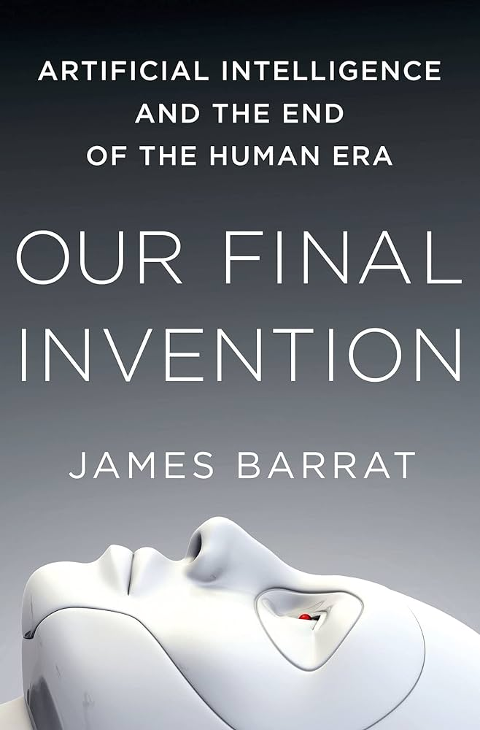
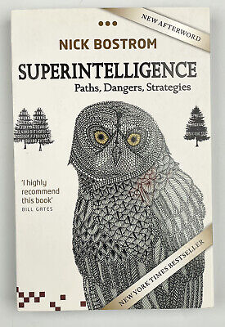
Checkpoint
This is not a class on the philosophy of AI
This is a pragmatic class on doing AI
If you are interested, I recommend the following books

Slide 22
The plan for the quarter (subject to change)
Three weeks studying search (exhaustive search, uninformed search, informed search, adversarial search)
Three weeks studying machine learning (nearest neighbor and decision trees classification, nueral networks and clustering)
Two weeks studying logic systems (propositional logic, first order logic, resolution)
A week of advanced topics (possible topics: genetic algorithms, Bayesian networks, similarity biometrics…)

Slide 23
The farmer, wolf, duck, corn problem
A farmer with his wolf, duck and bag of corn come to the east side of a river they wish to cross. There is a boat at the rivers edge, but of course only the farmer can row. The boat can only hold two things (including the rower) at any one time. If the wolf is ever left alone with the duck, the wolf will eat it. Similarly, if the duck is ever left alone with the corn, the duck will eat it. How can the farmer get across the river so that all four arrive safely on the other side.

Slide 24
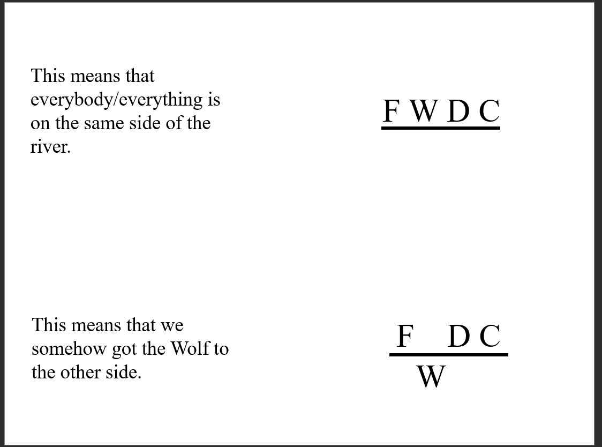

Slide 25
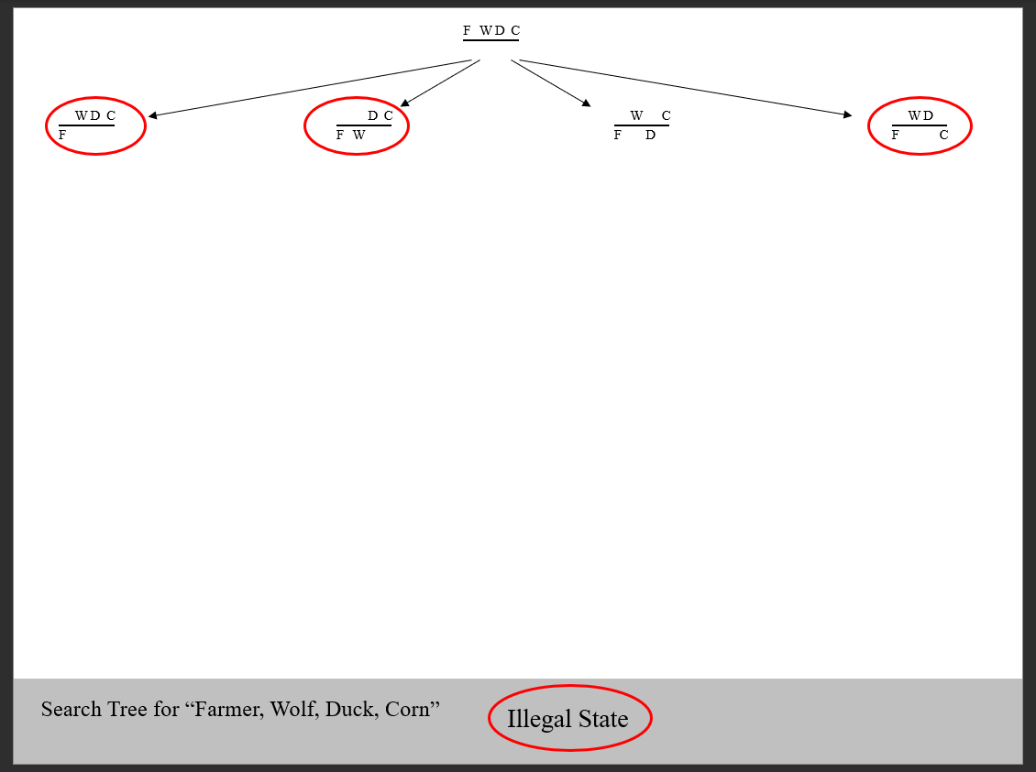

Slide 26
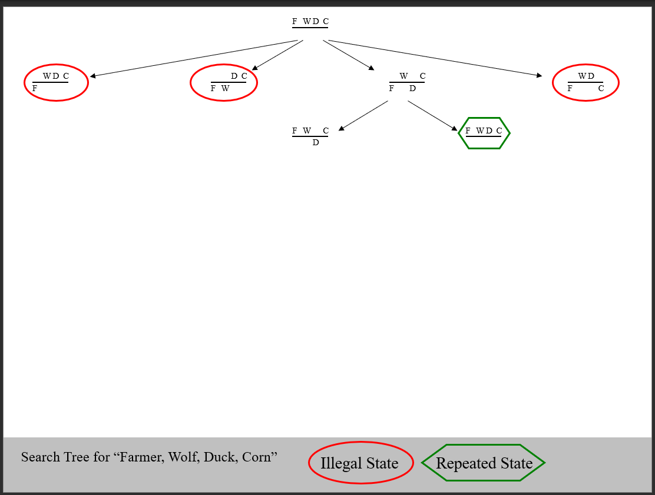

Slide 27
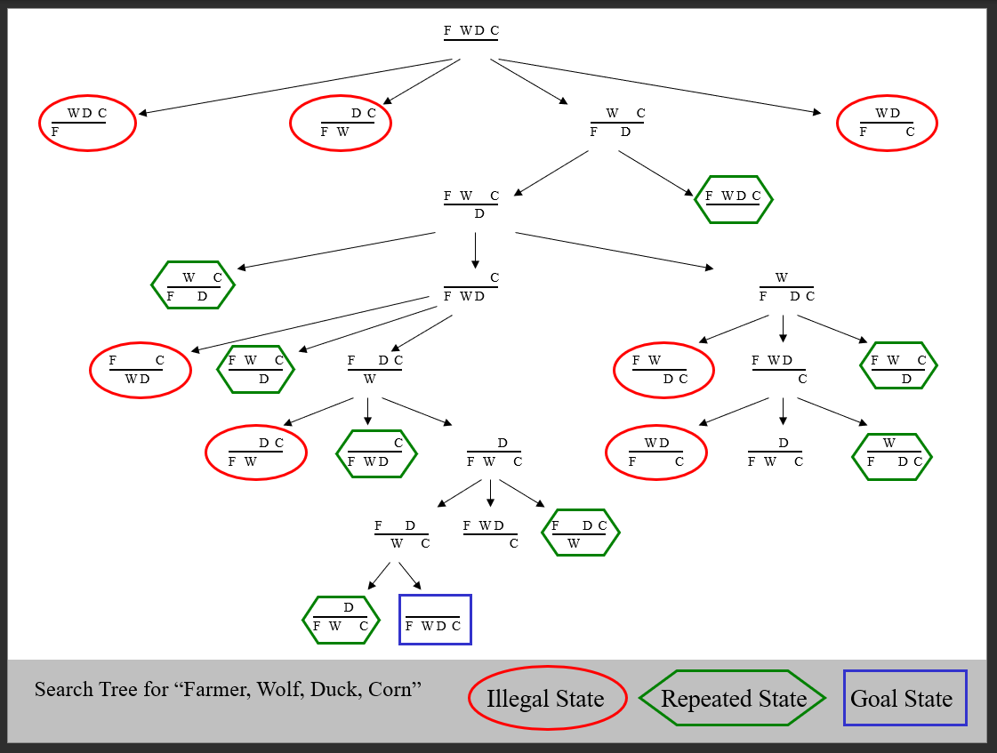

Slide 28
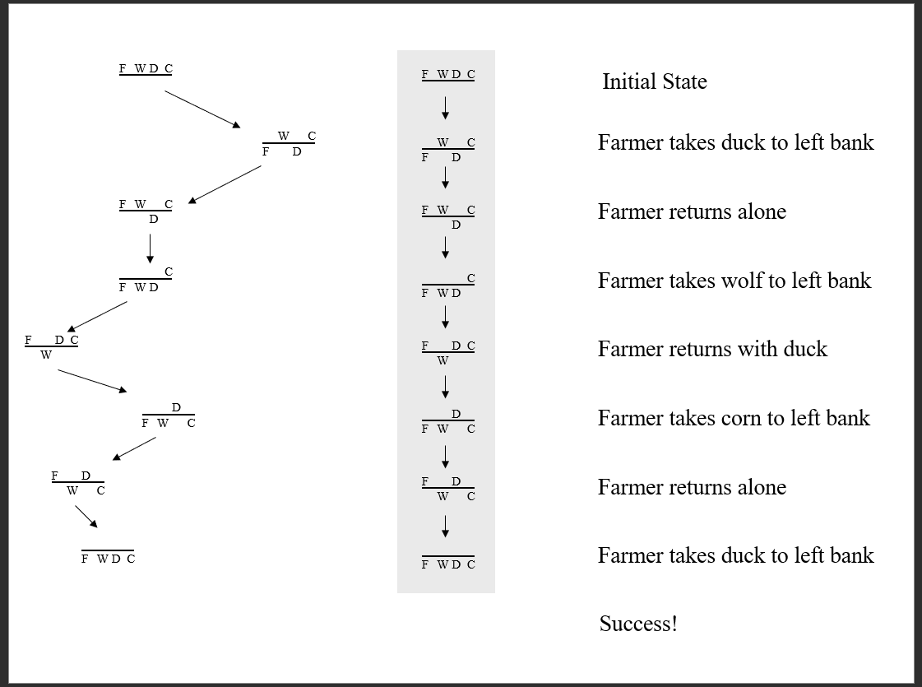

Slide 29
It is no surprise to learn that the technique used to solve Farmer, Wolf, Duck, Corn can be used to solve tother similar problems
Missionaries and Cannibals: (three of each, boat holds 2, if cannibals outnumber the missionaries they’ll eat them)
Jealous Husbands: three couples, boat holds 2 people at most, no wife can be left with any man unless her husband is also present
U2 has a concert that starts in 17 minutes and they must all cross a bridge to get there. All four men begin on the same side of the bridge. You must help them across to the other side. It is night. There is one flashlight. A maximum of two people can cross at one time.
Any party who crosses,e tiher 1 or 2 people, must have the flashlight with them. The flashlight must be walked back and forth, it cannot be thrown etc. Each band member wlaks at a different speed. A pair must walk together at the rate of the slower man’s pace. Bono takes 1 minute to cross, the Edge takes 2 minutes to cross. Adam takes 5 minutes to cross, and Larry takes 10 minutes to cross. How can they accomplish the crossing in the allowed time
What is surprising, is that search can be used to solve an amazing number of important problems that don’t appear (at first glance) to amiable to search…

Slide 30
For next time
Slides on Blind Search
Spend 10 minutes playing frogs and toads
https://nrich.maths.org/content/0012/game1/frogs/index.html#student/2/2

Slide 31
That was a search
Now lets preview machine learning

Slide 32
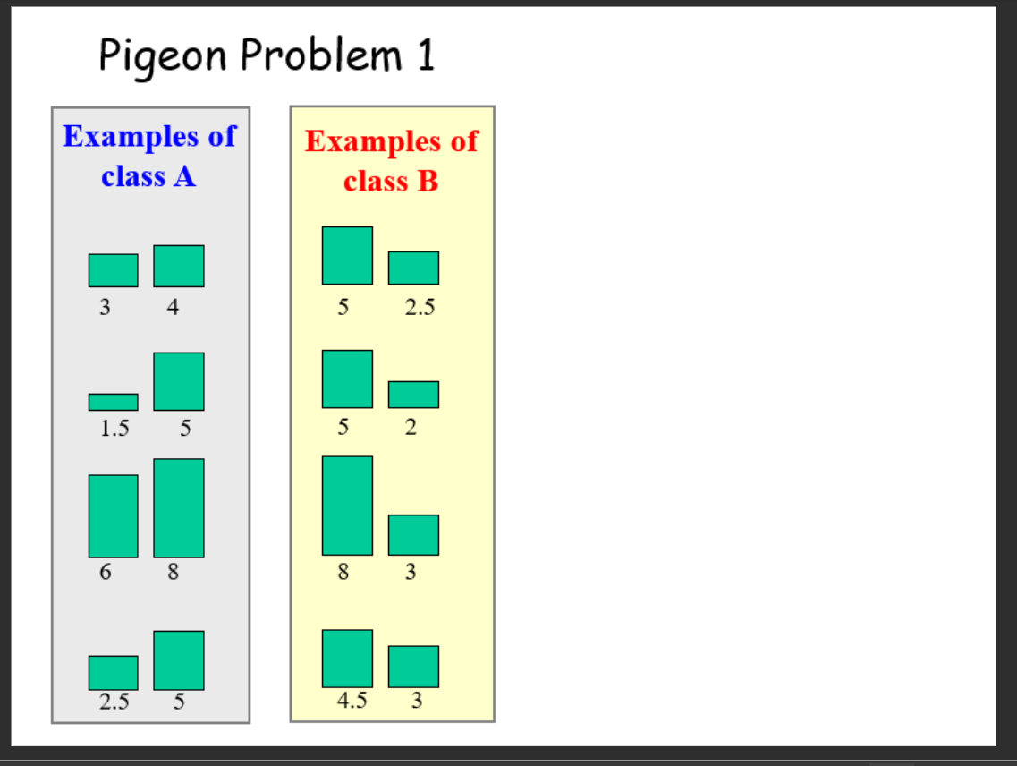

Slide 33
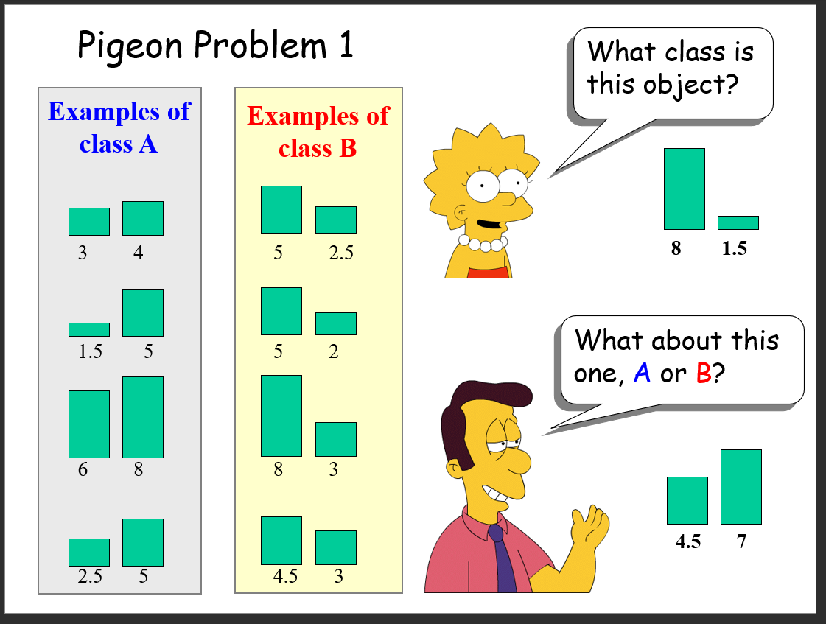

Slide 34
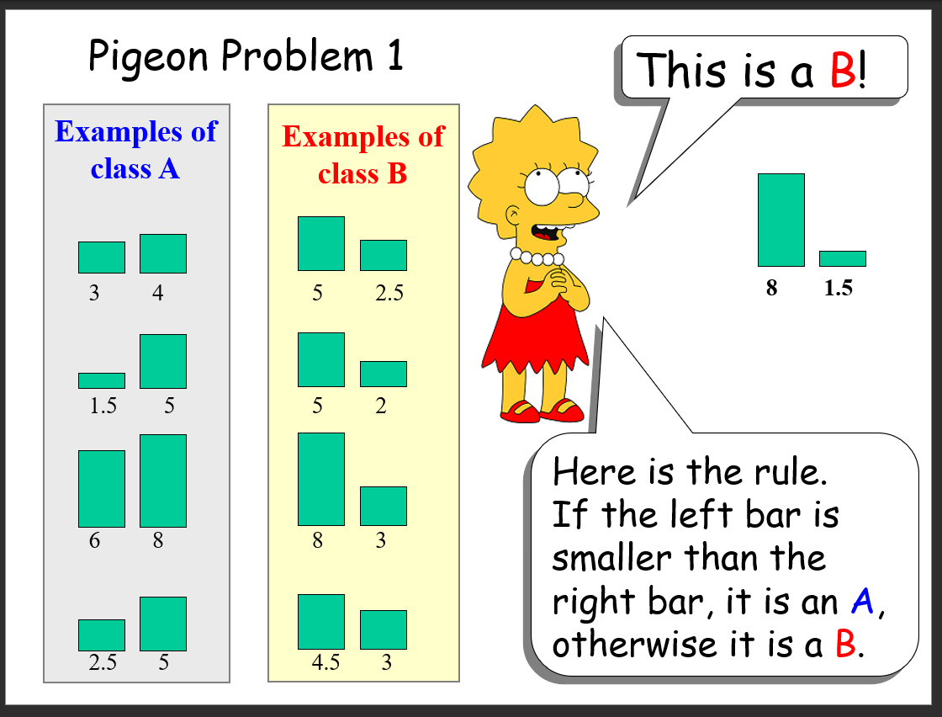

Slide 35
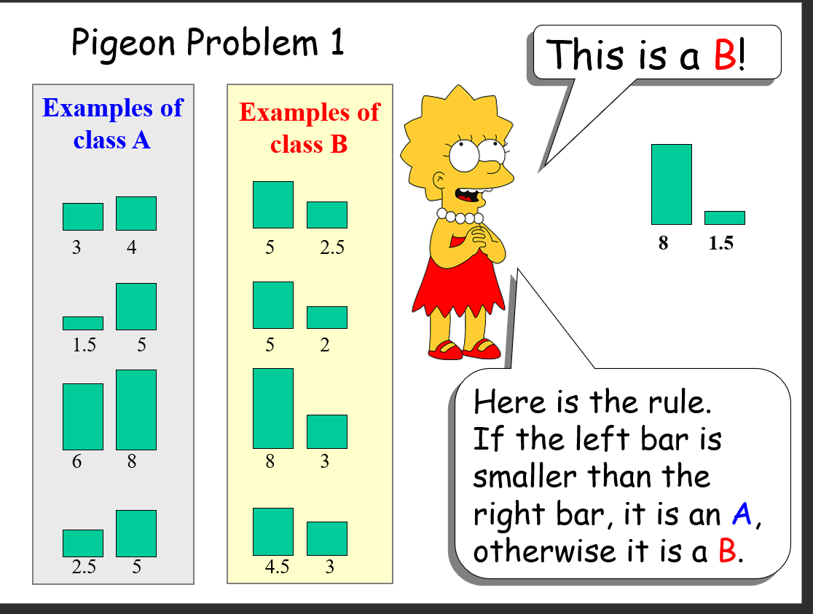

Slide 36
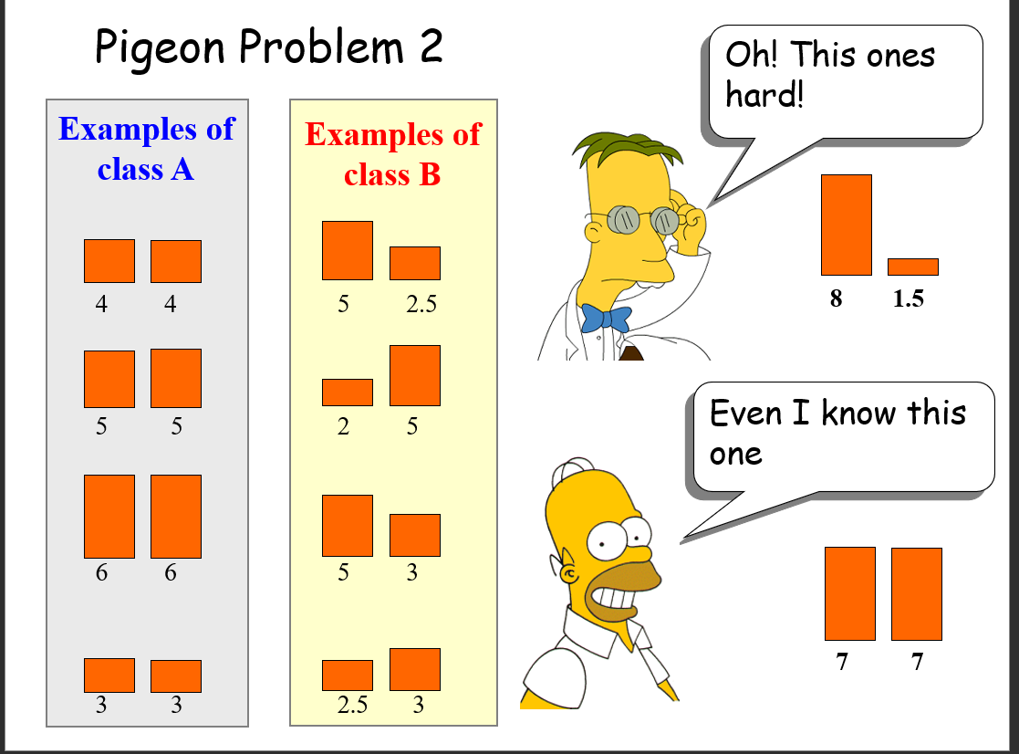

Slide 37
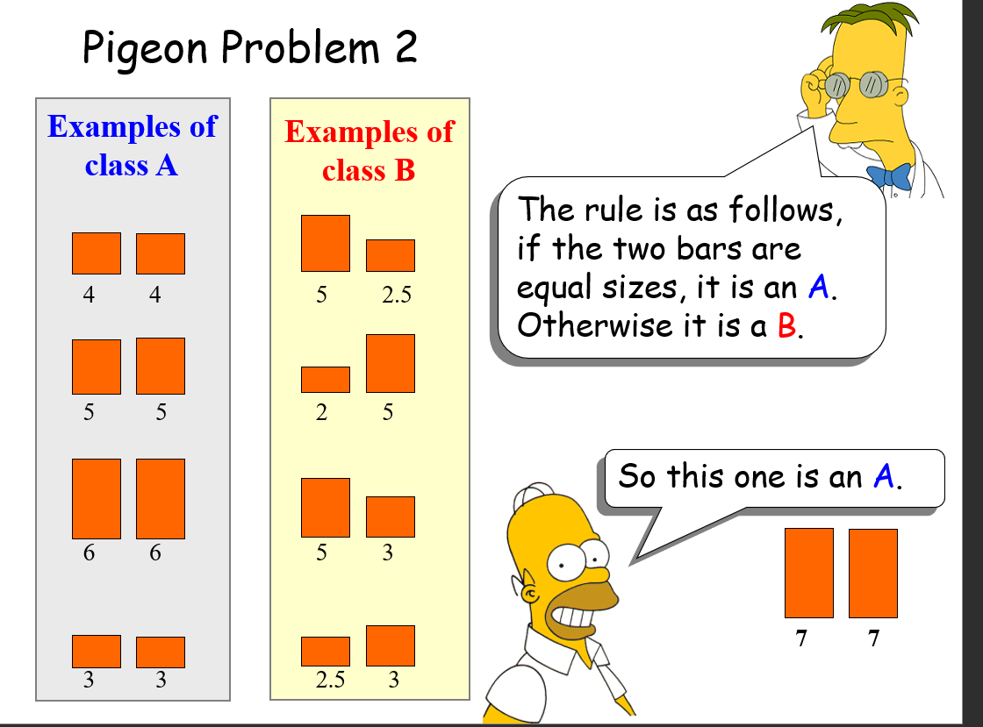

Slide 38
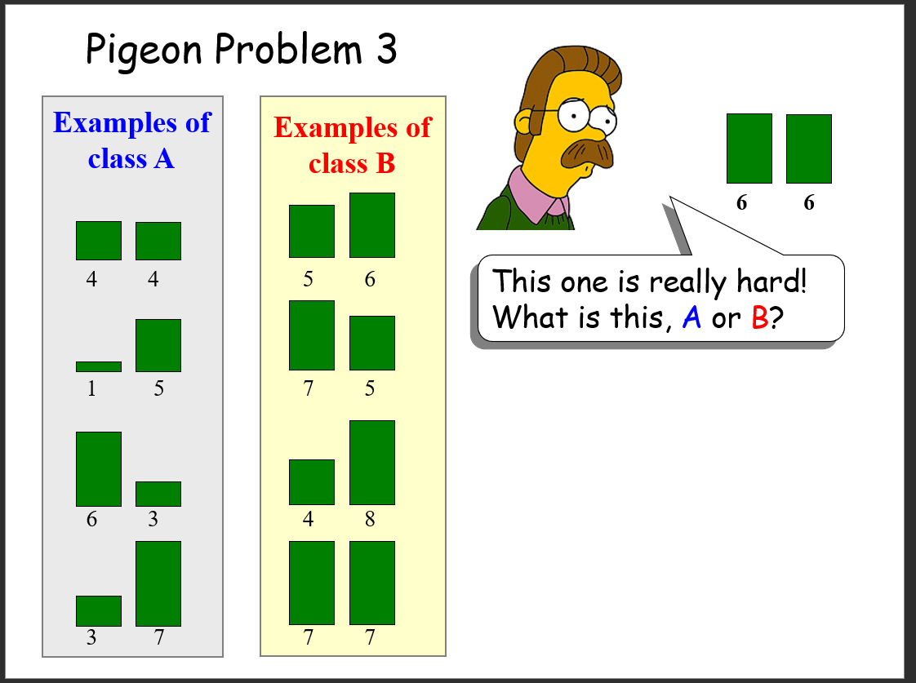

Slide 39
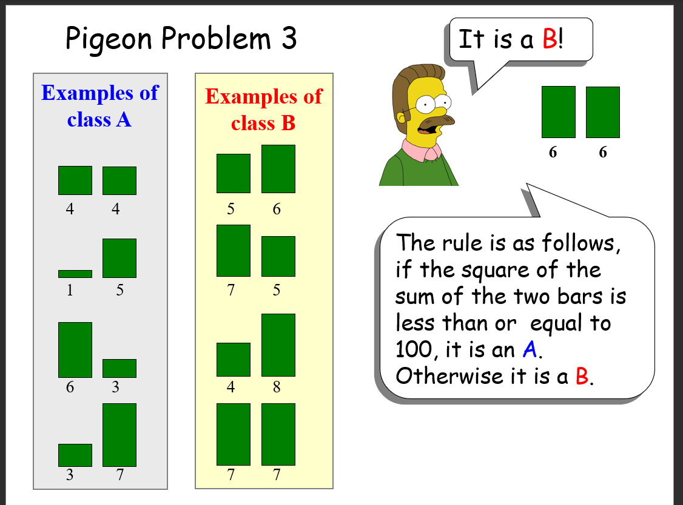

Slide 40
The “game” we have just been playing is Supervised Classification, a sub-field of Machine Learning, which is itself a sub-field of artificial intelligence.
Why is it useful

Slide 41
Machine Learning can be used to learn…
Who might die of a certain disease
Which people are likely to default of their credit card loan
Which new movies you might enjoy
Whether or not this X-ray of a suitcase shows a bomb
Which webpages contain pornography
The best way to route an email
The most efficient settings for your car’s fuel injector
Should the autonomous car hit the gas or the brake
Etc. etc

Slide 42
Why is Machine Learning a hard problem?
There might be missing/noisy features
There might be irrelevant features
The features may be related
It might be hard to create a good representation of the data
We might “overfit” when learning
We might have problems with time/space complexity

Slide 43
That was Machine Learning…
Now lets preview Knowledge Representation (reasoning)

Slide 44
Knowledge Representation I
Suppose I tell you that
Bob weighs 12 pounds
Bob likes to chase mice
Bob is afraid of dogs
….if someone asked you “What is Bob?”, what would you say?

Slide 45
Knowledge Representation II
This ability of humans (and to a lesser extent other animals) to be able to take a set of facts and a set of rules for manipulating facts, then to come up with new facts is at the heart of intelligence
This is true at a high level…
Given a set of facts about physics and math, Einstein was able to come up with a new fact, E = MC^2
And a low level…
Given a set of facts* about the Accounting Assistant in the CS department, I was able to come up with the fact that she is married
*She wears a ring on the left “ring” finger
Her business card has a last name scratched out and a new name penciled in

Slide 46
The most intelligent object in the universe
The human brain is currently the most intelligent device in the known universe
It has held that record for perhaps a ½ million years (before that, whales, elephants, other primates were about as smart)
Examples:
-In 1655/66 a single human mind invented discovered most of classic physics and calculus
-In the 1850’s a single human mind discovered the explanation for the diversity of life on Earth
-In 1904/5 a single human mind wrote four papers, Photoelectric effect, Brownian motion, Special relativity, Matter-energy equivalence, any one of these ideas was worth a nobel prize

Slide 47
The most intelligent object in the universe
The human brain weighs about 3lbs. Not as large as an elephant or a whale etc.
We can normalize for size in a few ways: The encephalization (EQ) level is a measure of relative brain size defined as the ratio between actual brain mass and predicted brain mass for an animal of a given size
Mean EQ for mammals is around 1. Animals tend to have higher EQ if: they are social, they need to catch prey/have complex diets, they live in a 3D world (trees, ocean, the air)
Even given that humans are social, omnivorous and evolved from tree dwellers, we are unexpectedly large brained
Why do humans have big brains? (why are we so smart)

